Slide 1

COURSE: B.Sc. (PROGRAMME) IN ECONOMICS
PAPER NAME – MACROECONOMICS II
TOPIC –ABSOLUTE ADVANTAGE THEORY AND COMPARATIVE COST ADVANTAGE THEORY
YEAR- THIRD SEMESTER-6 SESSION -2022-2023
DATE OF LECTURE: 20/05/2023
PREPARED BY
DR. KAMALIKA CHAKRABORTY
ASSISTANT PROFESSOR (DEPARTMENT OF ECONOMICS)
KHATRA ADIBASI MAHAVIDYALAYA, BANKURA, WEST BENGAL

Slide 2
ADAM SMITH’S ABSOLUTE ADVANTAGE THEORY
The theory of absolute advantage was put forward by Adam Smith. Smith argued that different countries enjoy absolute advantage in the production of some goods which formed the basis of trade between the countries
To produce one unit of wheat in the U.S.A. 3 man-hours and in India 10 man-hours are required. On the other hand, to produce one unit of cloth, in the U.S.A. 6 man-hours and in India 4 man-hours are required. Thus the U.S.A. can produce wheat more efficiently (that is, at a lower cost), while India can produce cloth more efficiently
Adam Smith showed that the two countries would benefit and world output will increase if the two countries specialize in the production of goods in which they have absolute advantage and trade with each other.

Slide 3
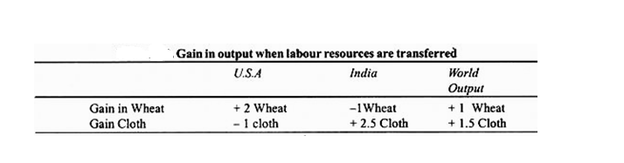
Suppose to specialize in the production of Wheat, the U.S.A. withdraws 6 man-hours from the production of cloth and devote them to the production of wheat, it will lose 1 unit of cloth and gain 2 units of wheat.
Similarly, to specialize in the production of cloth if India withdraws 10 hours of labour from wheat and use them for the production of cloth, it will lose one unit of wheat but gain 2.5 units of cloth.
In this way, transfer of labour resources to the goods in which they have absolute advantage, will result in the net gain of one unit of wheat and 2.5 units of cloth. The gain in output can be distributed between the two countries through voluntary exchange.

Slide 4
RICARDO’S COMPARATIVE COST ADVANTAGE THEORY
The Law of Comparative Advantage
David Ricardo was the proponent of Comparative cost Advantage Theory. According to him international trade is governed by the comparative cost advantage rather than the absolute cost advantage. In a two-nation and two-commodity world economy, even if one nation is less efficient than the other nation in the production of both commodities, there is still a basis for mutually beneficial trade. A country will specialise in in the production of that good in which it has a greater relative or comparative advantage in costs than other countries and will import all such commodities from abroad in which it has relative cost disadvantage. The Ricardian model is based on technological differences across countries. These technological differences are reflected in differences in the productivity of labor.

Slide 5
Assumptions of the model:
  Two countries(Home and Foreign) and two commodities world Free Trade takes place between the two countries
  There is only one factor of production i.e. labour and the cost of producing a commodity is expressed in labour units
  There is perfect mobility of labor within each nation but immobility between the two nations
  Constant costs of production
  No transportation cost
  No technical change
  There is full employment of resources in both the countries.
There is no intervention by the government in economic system
Perfect competition exists both in the commodity and factor markets

Slide 6
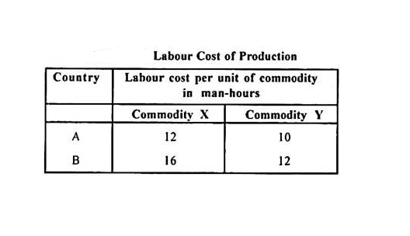
Country A has an absolute advantage in producing both the commodities through smaller inputs of labour than in country B. In relative terms, however, country A has comparative advantage in specialising in the production and export of commodity X while country B will specialise in the production and export of commodity Y.
In country A, domestic exchange ratio between X and Y is 12 : 10, i.e., 1 unit of X = 12/10 or 1.20 units of Y. Alternatively, 1 unit of Y= 10/12 or 0.83 units of X.
In country B, the domestic exchange ratio is 16 : 12, i.e., 1 unit of X = 16/12 or 1.33 units of Y. Alternatively, 1 unit of Y = 16/12 or 0.75 unit of X.
From the above cost ratios, it follows that country A has comparative cost advantage in the production of X and B has comparatively lesser cost disadvantage in the production of Y.

Slide 7
References:
https://www.economicsdiscussion.net/international-trade/the-theory-of-absolute-advantage/10705#
https://www.economicsdiscussion.net/economic-theories/comparative-costs-theory/david-ricardos-theory-of-comparative-cost-advantage-economics/30673

Slide 8
Thank You

